Slide 1

THREE METHODS OF PREDICTING DIABETES
ITEC-620-001 FINAL PROJECT
YU CHIEH CHENG
HE JIN CHU
CHUEH HSIEN LUO

Slide 2
DATASET INTRODUCTION
Diabetes Dataset
National Institute of Diabetes and Digestive and Kidney Diseases
Observer all females and at least 21 years old of Pima Indian heritage
Rows: 768 ; Columns: 9
Total of 6,912 records

Slide 3
ISSUE BEING ANALYZED
Predict based on diagnostic measurements whether a patient has diabetes
Dependent variable: Outcome(1:Yes 0:No)
Independent variables: Pregnancies, Glucose, Blood Pressure, Skin Thickness, Insulin, BMI, Diabetes Pedigree Function, Age

Slide 4
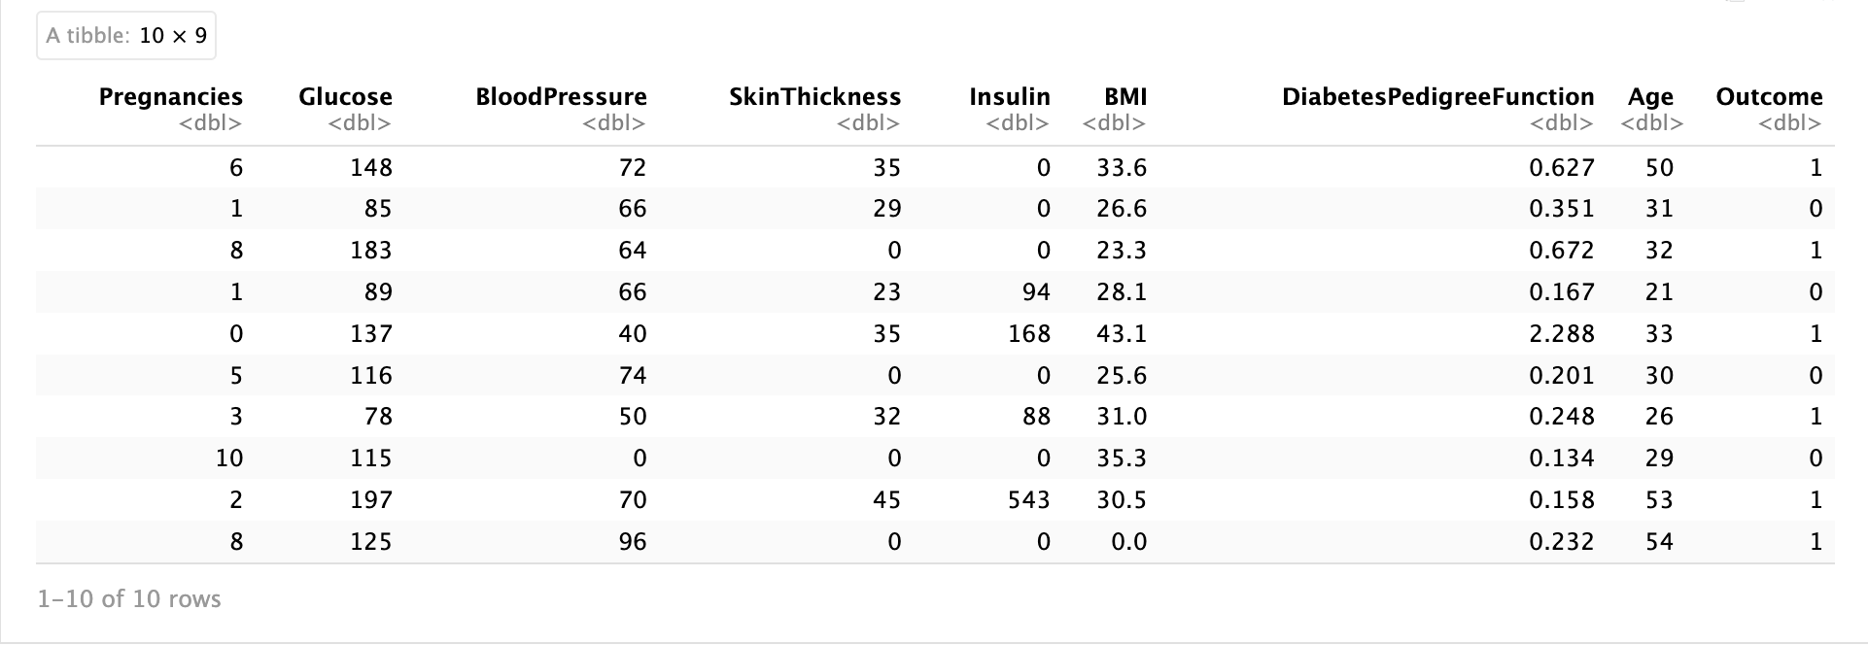
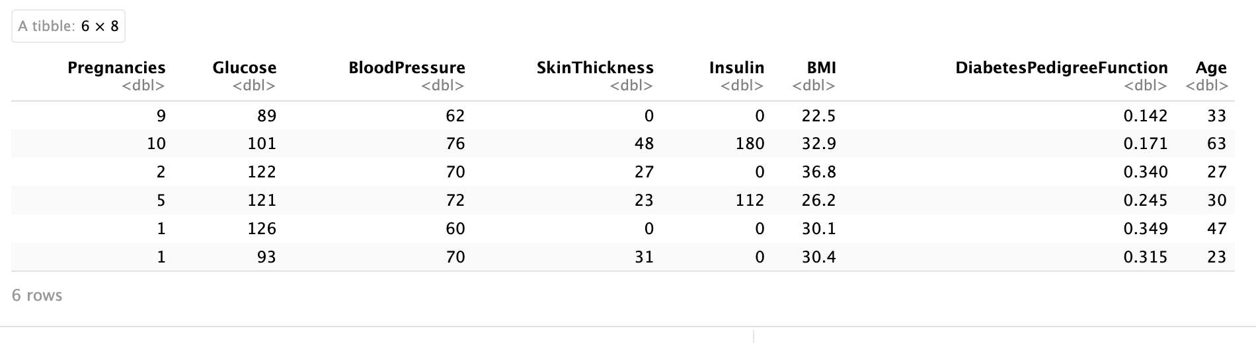
SNAPSHOT OF THE DATA SET
Original dataset
New data selected from original dataset

Slide 5
MISSING VALUES DETECTION
Using is.na function and colSums function

Slide 6
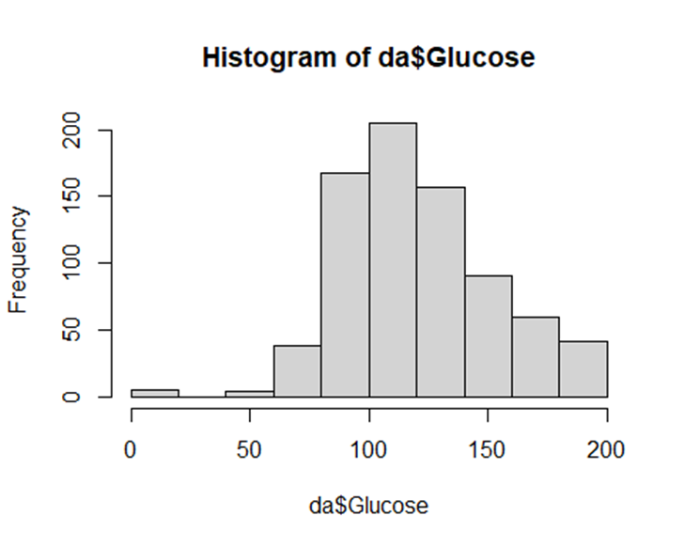
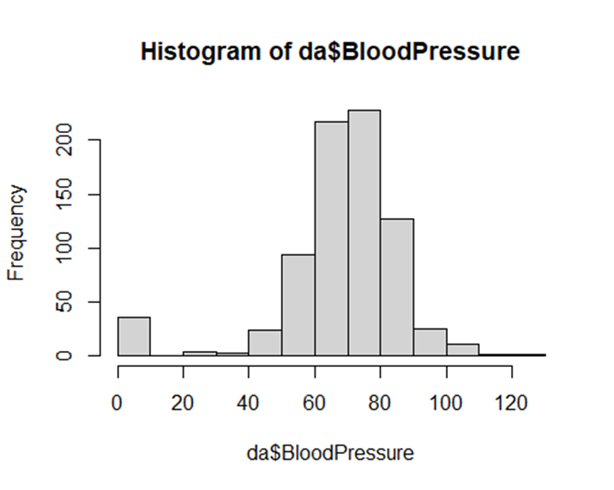
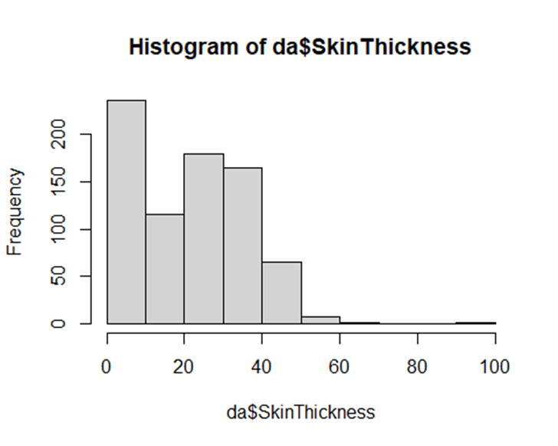
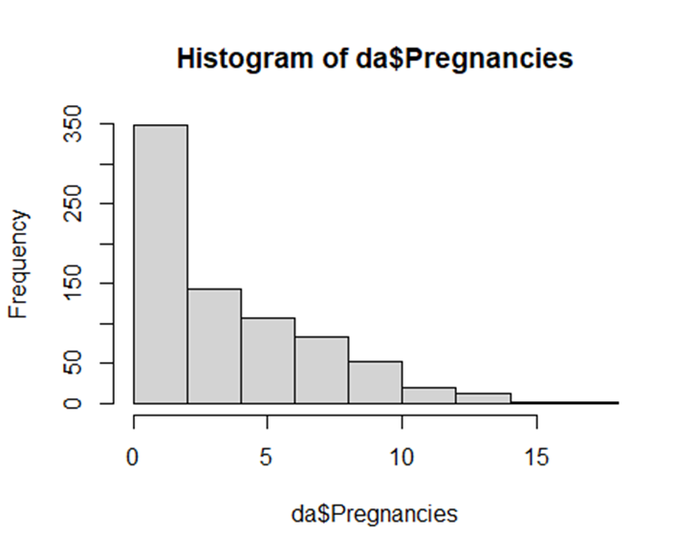
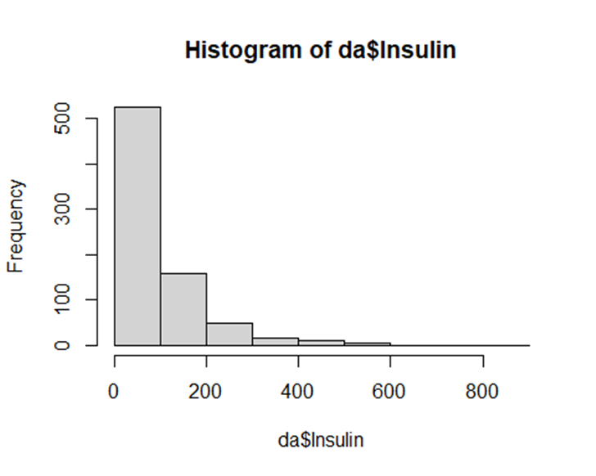
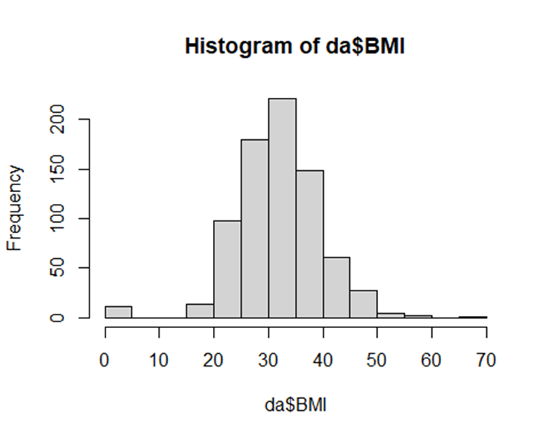
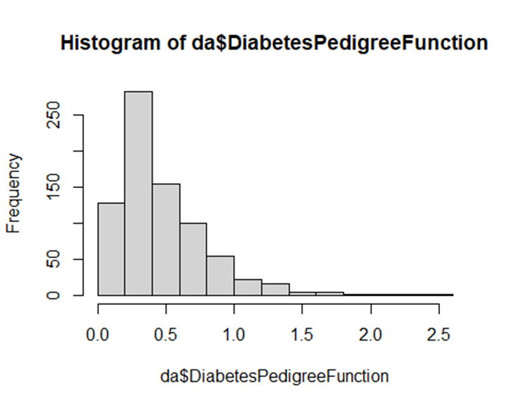
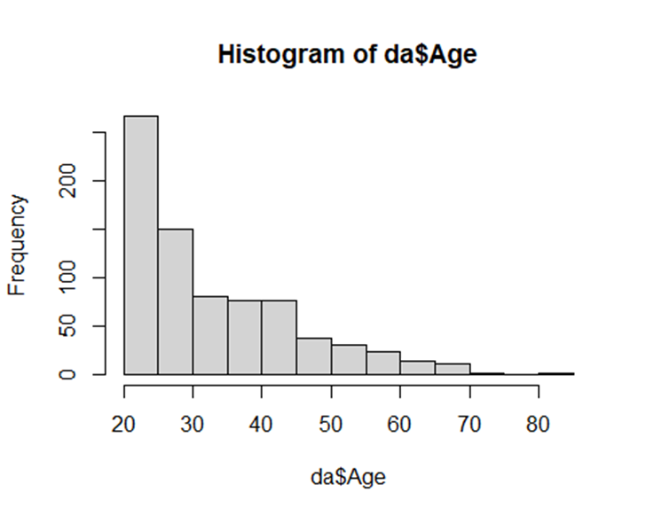
HISTOGRAM

Slide 7
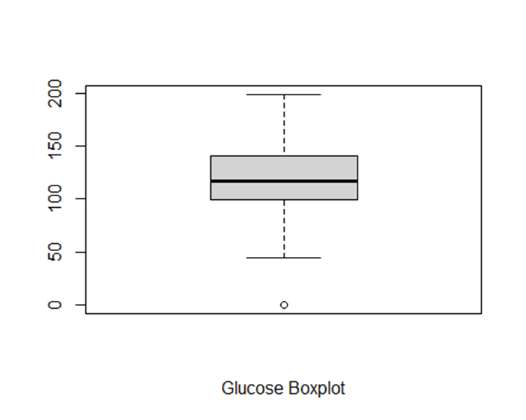
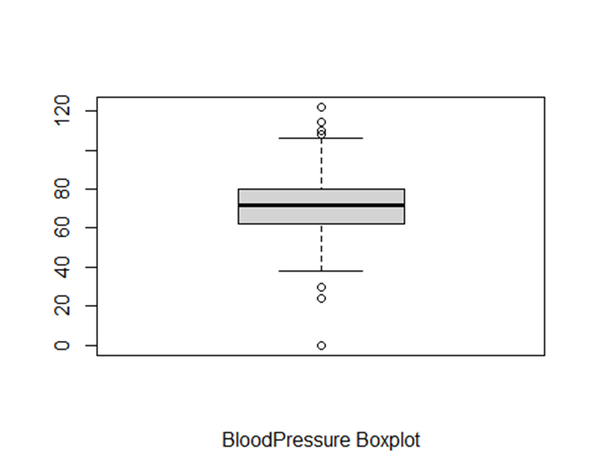
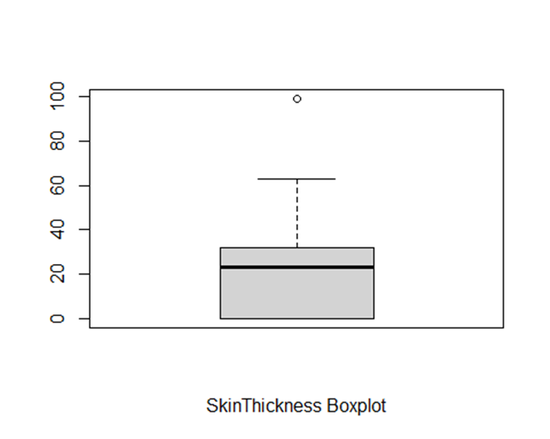
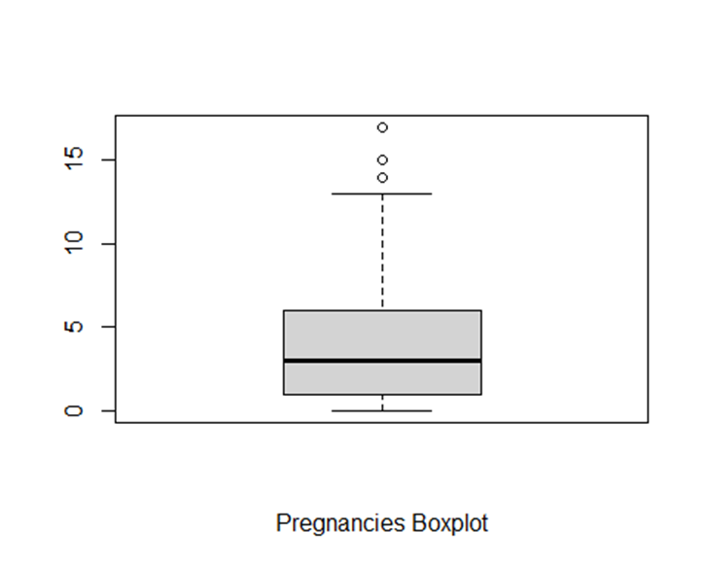
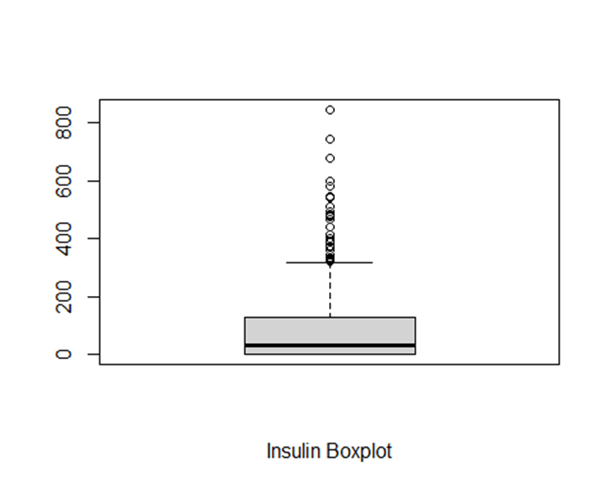
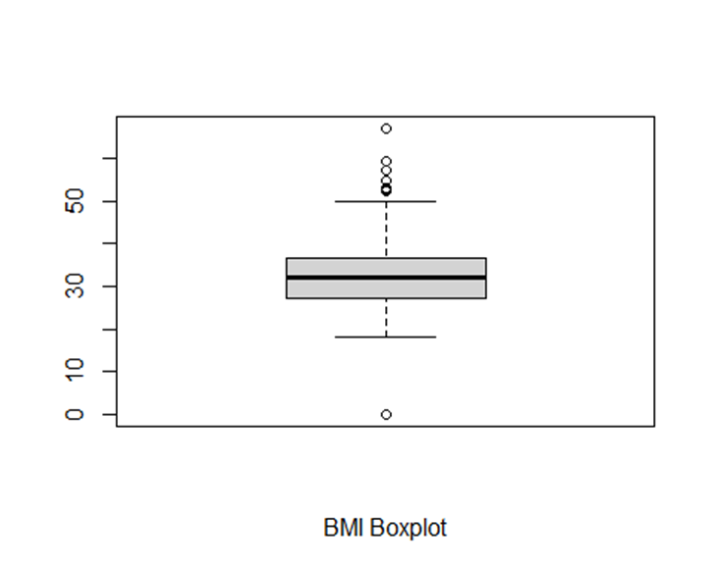
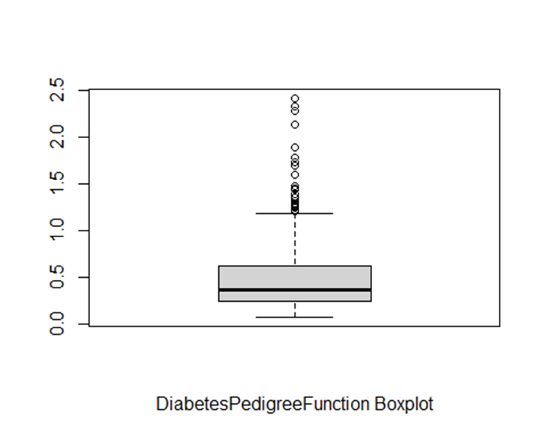
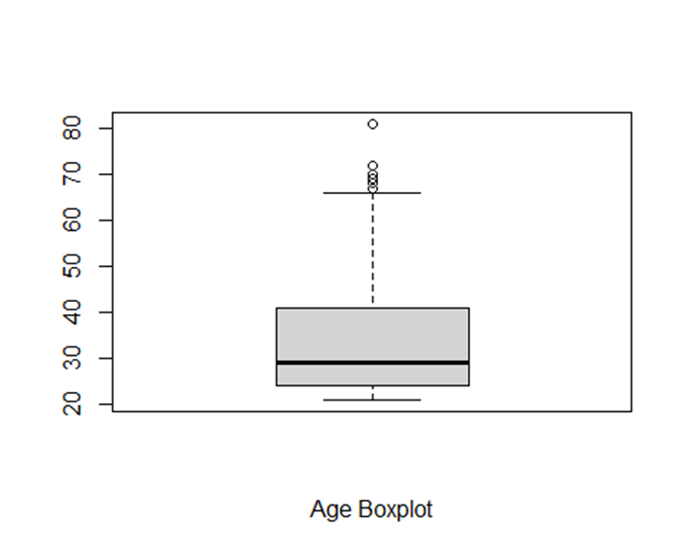
BOXPLOT

Slide 8
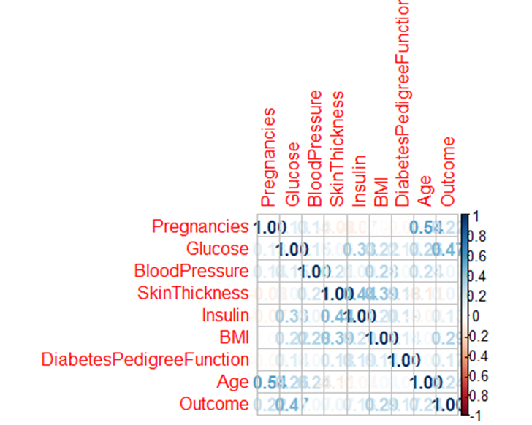
CORRELATION BETWEEN INDEPENDENT and DEPENDENT VARIABLES
There are low positive correlations between independent and dependent variables.

Slide 9

NORMALIZATION
Using scale function to normalize numeric data into z score and set.seed to make sure every output from randomness will be the same.

Slide 10
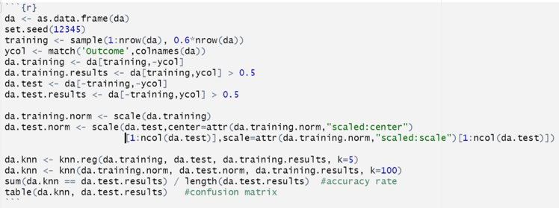
ANALYSIS METHOD 1 – KNN(1/2)
Diabetes .test.results
da.knn | FALSE | TRUE
FALSE | 189 | 77
TRUE | 14 | 28
Accuracy rate: 0.7045455

Slide 11
ANALYSIS METHOD 1 – KNN(2/2)
Predict numbers: 0.23, 0.51, 0.20, 0.23, 0.34, 0.09

Slide 12
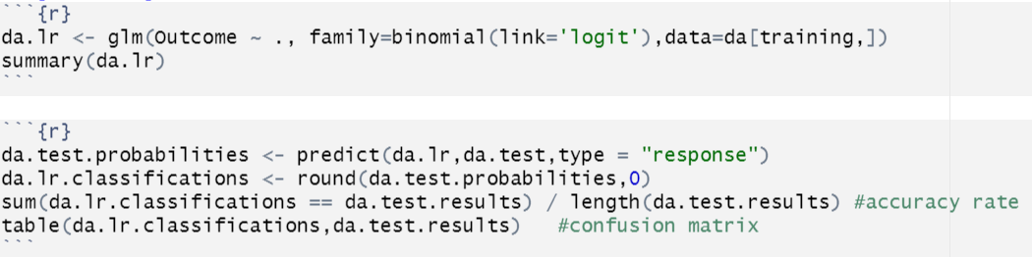
ANALYSIS METHOD 2 -- LOGISTIC REGRESSION(1/2)
Diabetes .test. results
Classifications | FALSE | TRUE
0 | 177 | 41
1 | 26 | 64
Accuracy rate: 0.7824675

Slide 13
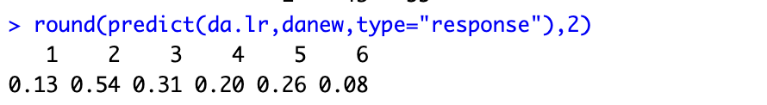
ANALYSIS METHOD 2 -- LOGISTIC REGRESSION(2/2)
Predict numbers: 0.13, 0.54, 0.31, 0.20, 0.26, 0.08

Slide 14
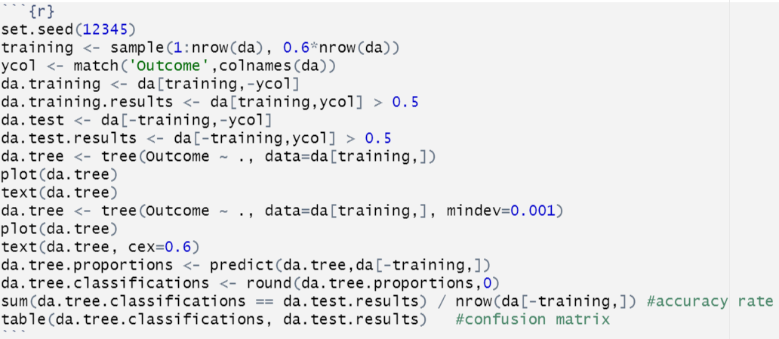
ANALYSIS METHOD 3 -- CLASSIFICATION TREE(1/3)
Diabetes .test.results
da.tree.classifications | FALSE | TRUE
0 | 160 | 50
1 | 43 | 55
Accuracy rate: 0.6980519

Slide 15
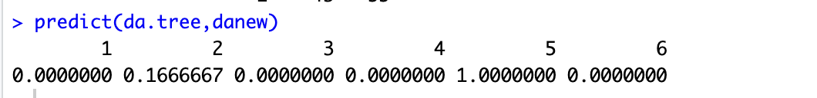
ANALYSIS METHOD 3 -- CLASSIFICATION TREE(2/3)
Predict numbers: 0.00, 0.17, 0.00, 0.00, 1.00, 0.00

Slide 16
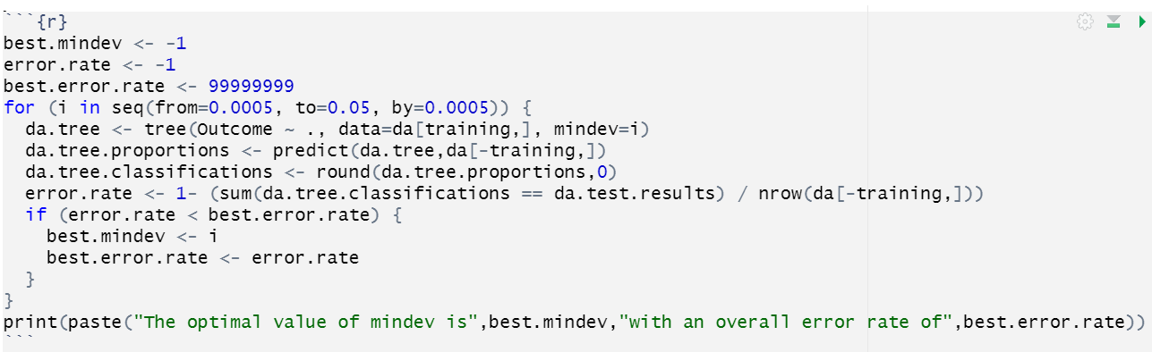
ANALYSIS METHOD 3 -- CLASSIFICATION TREE(3/3)
The optimal value of mindev is 0.0075 with an overall error rate of 0.282467532467532
The tree correctly classified 71.75% of the observation in test data

Slide 17
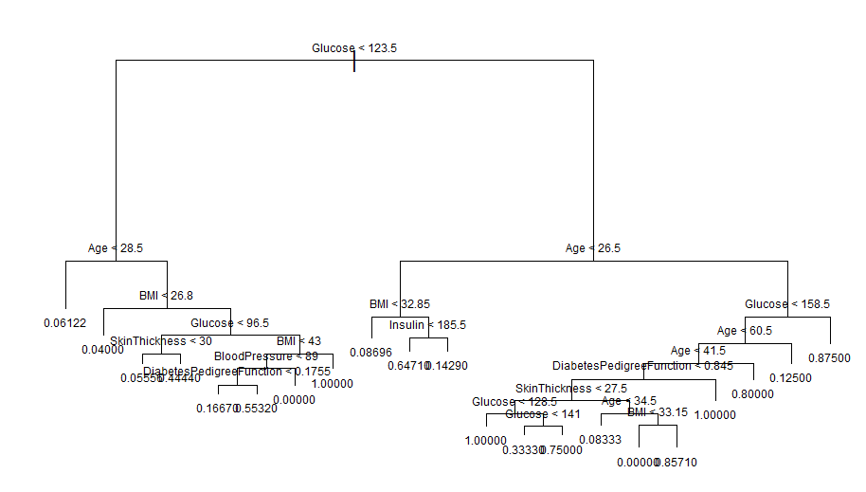
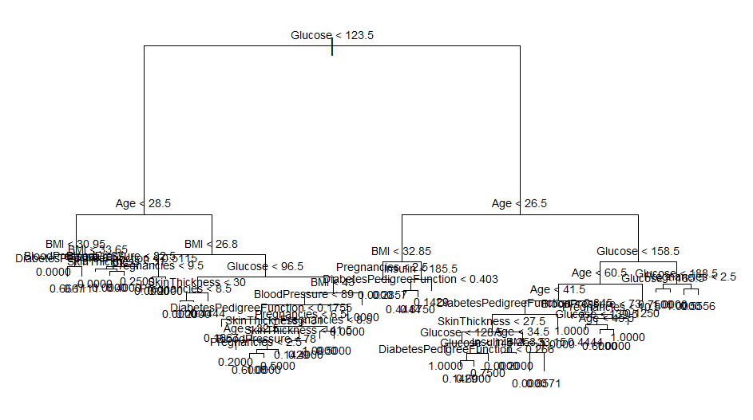
CLASSIFICATION TREE COMPARE
Original tree plot
The best mindev tree plot

Slide 18

PREDICTION RESULT
 | KNN | Logistic Regression | Classification Tree
Predict Number | 0.23, 0.51, 0.20, 0.23, 0.34, 0.09 | 0.13, 0.54, 0.31, 0.20, 0.26, 0.08 | 0.00, 0.17, 0.00, 0.00, 1.00, 0.00
Accuracy rate | 0.7045455 | 0.7824675 | 0.6980519
This is a table that organizes the accuracy and prediction values of the above three methods

Slide 19
IMPLICATION FOR DECISION MAKER
According to the result of accuracy rate, we can know the highest accuracy rate is logistic regression.
We think if decision maker wants to know more about the dataset, they could try logistic regression to predict numbers.

Slide 20
CHALLENGES WITH ANALYZING AND MODELING
A limited data set
The data only has 798 samples
Do not accurately represent the population
Only select females over 21 years old of Pima Indian heritage but cannot represent for all population
Outliers that may influence outcome
Wrong conclusions

Slide 21
THANK YOU

